Slide 1
24-bit Audio CODEC
數位電路實驗
TA: 吳柏辰
Authors
V1: Trumen
V2: johnjohnlin

Slide 2
Outline
Introduction to Audio Signal
Architecture Overview
Device Initialization
Device Operation

Slide 3
Introduction to Audio Signal

Slide 4
Introduction
An audio signal is a representation of sound, typically as an electrical voltage.
Audio signals have frequencies in the audio frequency range of roughly 20 to 20,000 Hz.
Audio signals may be synthesized directly, or may originate at a transducer such as a microphone.
Loudspeakers or headphones convert an electrical audio signal into sound.

Slide 5
// Line Level (1/2)
Line level is the specified strength of an audio signal used to transmit analog sound between audio components.
As opposed to line level, there are weaker audio signals, such as those from microphones, and stronger signals, such as those used to drive headphones and loudspeakers.
Notes:
Line level is the level of the signal of almost any electronic instrument that is not a microphone. Synths, Keyboards, Drum Machines etc... (Excluding Guitars because this is an impedance issue) Line level is usually high enough directly from the instrument to be recorded without boosting the signal.
(from http://duc.avid.com/showthread.php?t=58854)

Slide 6
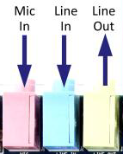
Line Level (2/2)
Consumer electronic devices concerned with audio (for example sound cards) often have a connector labeled "line in" and/or "line out."
The line in/out connections on a consumer-oriented computer sound card are unbalanced, with a 3.5 mm (1/8") 3-conductor TRS minijack connector providing ground, left channel, and right channel.
Professional equipment commonly uses balanced connections on 6.35 mm (1/4") phone jacks or XLR connectors.
Notes:
In telecommunications and professional audio, a balanced line or balanced signal pair is a transmission line consisting of two conductors of the same type, each of which have equal impedances along their lengths and equal impedances to ground and to other circuits.

Slide 7
Line In V.S. Mic In
A line input level signal typically has a voltage ranging from 0.3 to 2 Volts.
A microphone input level signal is more often in the range from 5 to 50 mV (millivolts).
Need microphone input level boost.

Slide 8
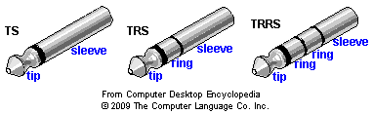
// Phone Connector (1/3)
In electronics, a phone connector is a common family of connector typically used for analog signals, primarily audio.
It is also termed an audio jack, phone jack, etc.
It is cylindrical in shape, typically with two, three or four contacts.
Three-contact versions are known as TRS connectors, where T stands for "tip", R stands for "ring" and S stands for "sleeve".
Similarly, two- and four-contact versions are called TS and TRRS connectors respectively.

Slide 9
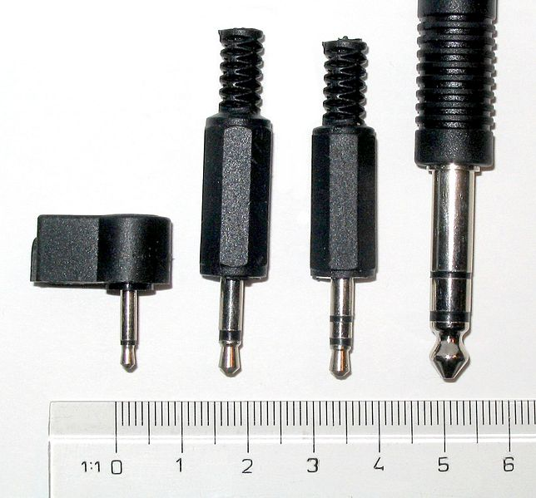
// Phone Connector (2/3)
Modern phone connectors are available in three standard sizes.
2.5 mm mono (TS)
3.5 mm mono (TS)
3.5 mm stereo (TRS)
6.35 mm (1⁄4 in) (TRS)

Slide 10
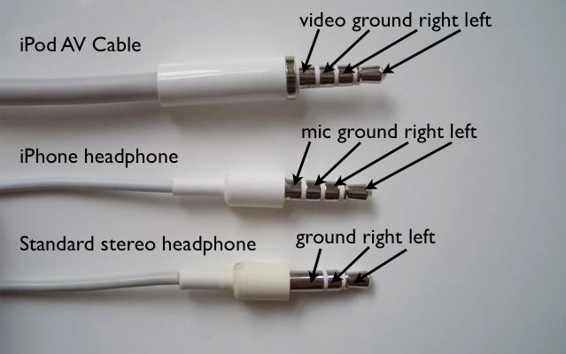
Phone Connector (3/3)
http://appleinsider.com/articles/09/02/12/macbook_owners_frustrated_by_new_audio_jacks

Slide 11
Architecture Overview

Slide 12
DE2_115_User_manual\DE2_115_User_manual.pdf

Slide 13
Schematic Diagram
DE2_115_User_manual\DE2_115_User_manual.pdf

Slide 14
Audio CODEC Pin Assignments
DE2_115_User_manual\DE2_115_User_manual.pdf
Signal Name | FPGA Pin No. | Description
I2C_SCLK | PIN_B7 | I2C Clock
I2C_SDAT | PIN_A8 | I2C Data
AUD_XCK | PIN_E1 | Audio CODEC Chip Clock
AUD_BCLK | PIN_F2 | Audio CODEC Bit-Steam Clock
AUD_ADCLRCK | PIN_C2 | Audio CODEC ADC LR Clock
AUD_ADCDAT | PIN_D2 | Audio CODEC ADC Data
AUD_DACLRCK | PIN_E3 | Audio CODEC DAC LR Clock
AUD_DACDAT | PIN_D1 | Audio CODEC DAC Data
Audio chip and TV decoder chip share one I2C bus

Slide 15
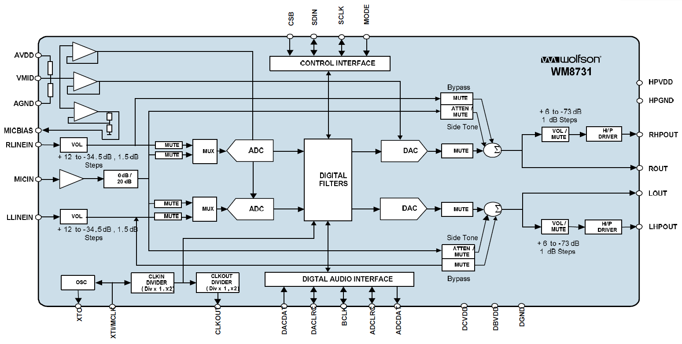
WM8731 Block Diagram
DE2_115_datasheets\Audio CODEC\WM8731.pdf

Slide 16
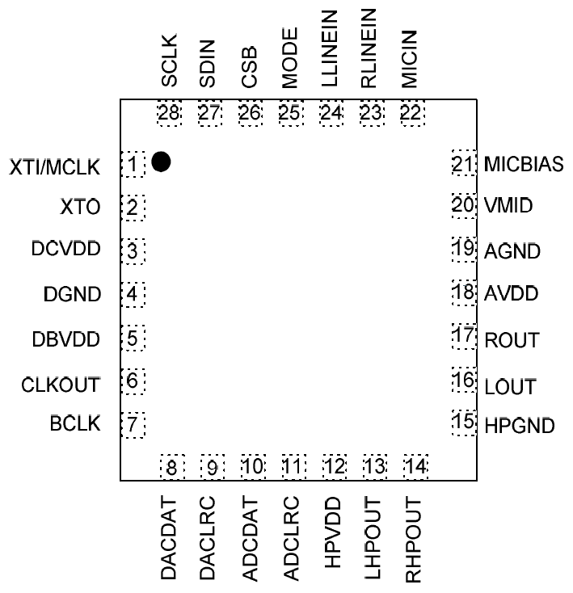
WM8731 Pin Configuration
DE2_115_datasheets\Audio CODEC\WM8731.pdf
Top view of 28 pin QFN

Slide 17
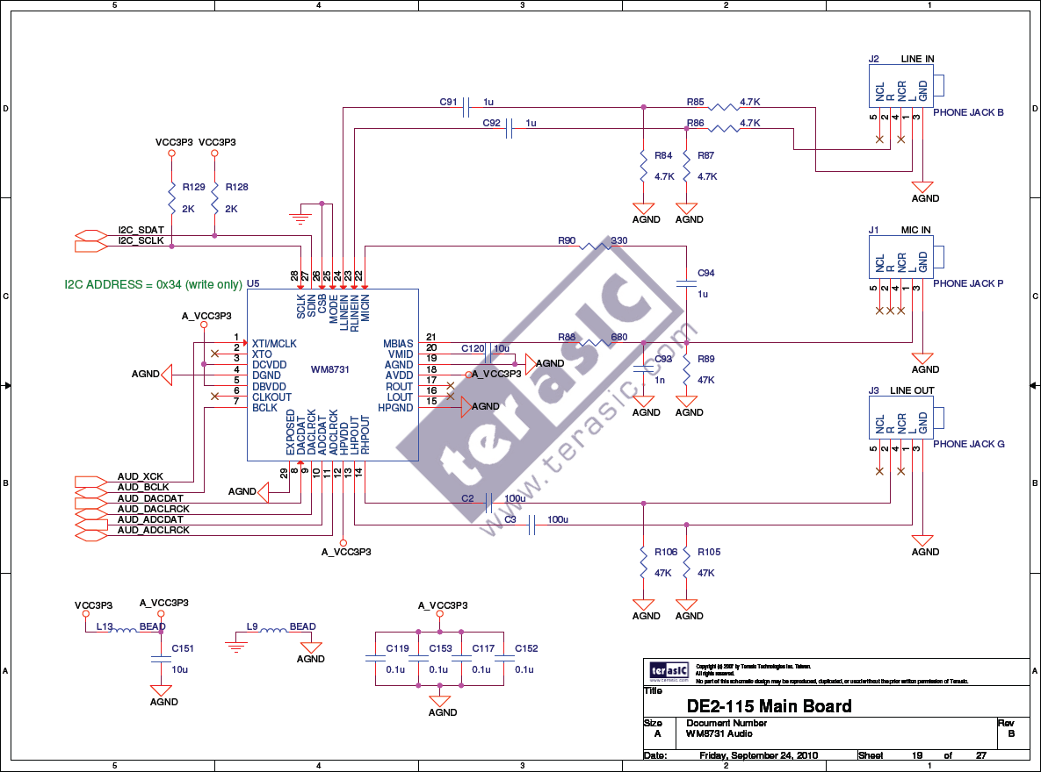
DE2_115_schematic\DE2-115_MB.pdf

Slide 18
How to Use WM8731?
Initialize the device by setting the registers via I2C bus interface.
After correct initialization, we can receive or transmit audio data via digital audio interface.

Slide 19
Device Initialization

Slide 20
Software Control Interface (1/2)
Different modes can be configured under software control.
Input to ADC: Microphone
Sampling rate: 32kHz
Input audio data bit length: 16 bits
etc.

Slide 21
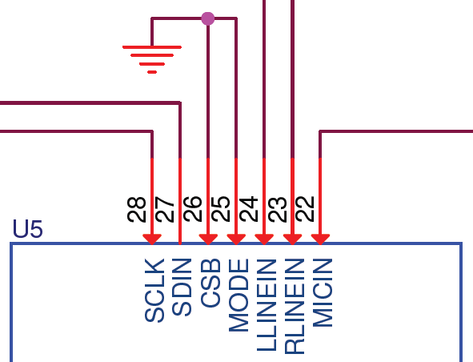
Software Control Interface (2/2)
Selection of serial control mode
The serial control interface may be selected to operate in either 2 or 3-wire modes. This is achieved by setting the state of the MODE pin.
MODE | INTERFACE FORMAT
0 | 2 wire
1 | 3 wire

Slide 22
// 2-Wire Serial Control Mode
The WM8731/L supports a 2-wire MPU (Microprocessor unit) interface, which is compatible with I²C protocol.
I²C (Inter-Integrated Circuit, referred to as I-squared-C) uses only two bidirectional open-drain lines, Serial Data Line (SDA) and Serial Clock (SCL).

Slide 23
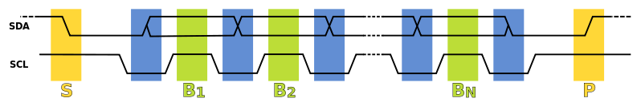
I²C protocol (1/3)
First, SDA↓ then SCL↓.
The data is transmitted with SCL is 1.
Finally, SCL↑ then SDA ↑.
Principle: When transmitting bits, never change SDA near by high-level SCL.

Slide 24
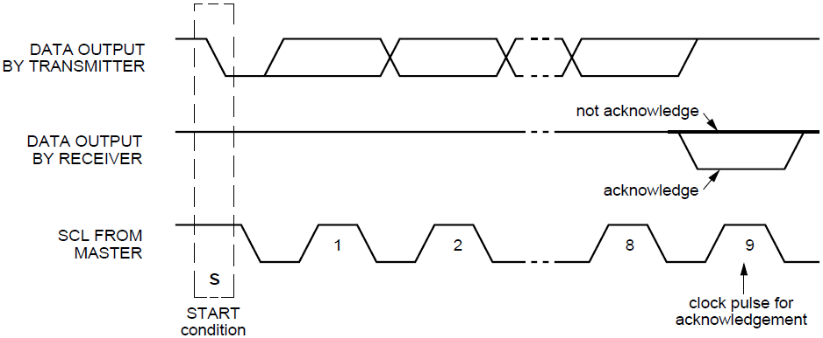
I²C protocol (2/3)
After every 8 data bits in one direction, an "acknowledge" bit (0) is transmitted in the other direction.

Slide 25
I²C protocol (3/3)
You will need inout port:
module inout_port(oe, clk, SDA)
input oe; // output enable
inout io;
logic i, o;
// You should have learnt what z means last year
assign io = oe? o: 1'bz;
// And you can use i whenever you need it.

Slide 26
2-Wire Interface (1/2)
The device operates as a slave device only.
The WM8731/L has one of two slave address that are selected by setting the state of the CSB pin.
CSB STATE | ADDRESS
0 | 0011010
1 | 0011011

Slide 27
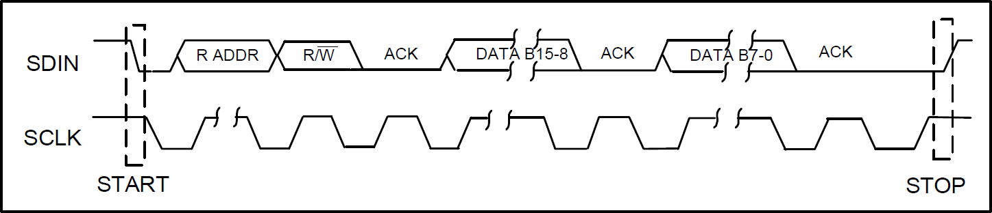
2-Wire Interface (2/2)
2-wire serial interface
ADDR[6:0] (7 bits) are Slave Address Bits
R/W is '0', indicating a write
B[15:9] (7 bits) are Register Address Bits
B[8:0] (9 bits) are Register Data Bits
0011010
0
Max freq. = 526 kHz

Slide 28
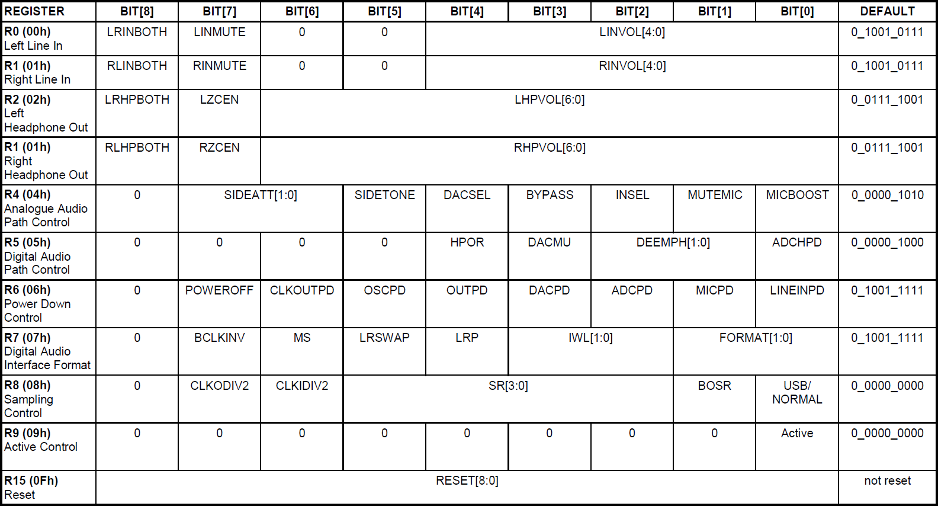
Register Map
Check the WM8731/L document to see the details.

Slide 29
Left Line In
Just use the default setting if we do not use the line input.
000_0000_0_1001_0111
REGISTER | BIT[8] | BIT[7] | BIT[6] | BIT[5] | BIT[4] | BIT[3] | BIT[2] | BIT[1] | BIT[0] | DEFAULT
R0 (00h) Left Line In | LRINBOTH | LINMUTE | 0 | 0 | LINVOL[4:0] |  |  |  |  | 0_1001_0111

Slide 30
Right Line In
Just use the default setting if we do not use the line input.
000_0001_0_1001_0111
REGISTER | BIT[8] | BIT[7] | BIT[6] | BIT[5] | BIT[4] | BIT[3] | BIT[2] | BIT[1] | BIT[0] | DEFAULT
R1 (01h) Right Line In | RLINBOTH | RINMUTE | 0 | 0 | RINVOL[4:0] |  |  |  |  | 0_1001_0111

Slide 31
Left Headphone Out
Here we can just use the default setting.
000_0010_0_0111_1001
REGISTER | BIT[8] | BIT[7] | BIT[6] | BIT[5] | BIT[4] | BIT[3] | BIT[2] | BIT[1] | BIT[0] | DEFAULT
R2 (02h) Left Headphone Out | LRHPBOTH | LZCEN | LHPVOL[6:0] |  |  |  |  |  |  | 0_0111_1001

Slide 32
Right Headphone Out
Here we can just use the default setting.
000_0011_0_0111_1001
REGISTER | BIT[8] | BIT[7] | BIT[6] | BIT[5] | BIT[4] | BIT[3] | BIT[2] | BIT[1] | BIT[0] | DEFAULT
R3 (03h) Right Headphone Out | RLHPBOTH | RZCEN | RHPVOL[6:0] |  |  |  |  |  |  | 0_0111_1001

Slide 33
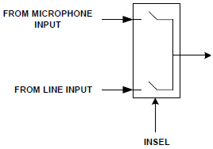
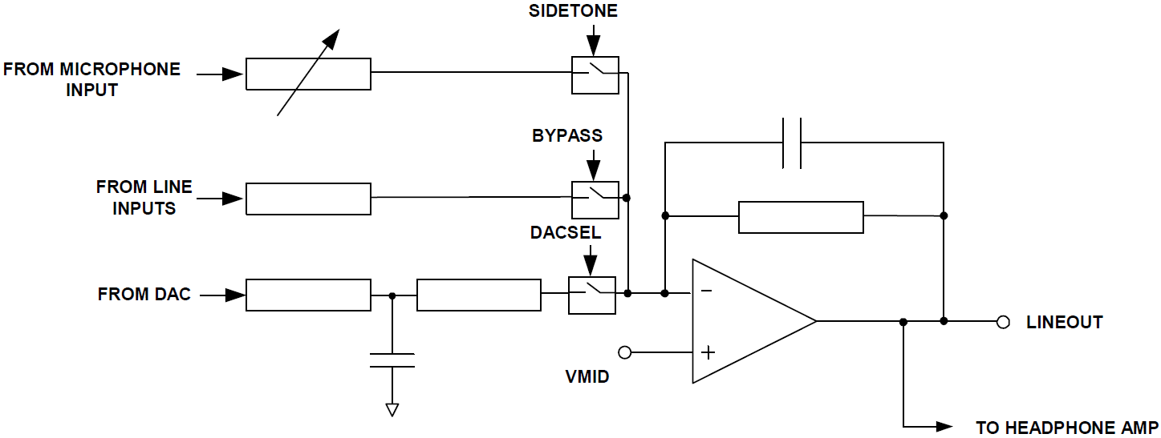
Analogue Audio Path Control
Enable boost, disable mute, choose microphone input, disable bypass, and select DAC.
000_0100_0_0001_0101
REGISTER | BIT[8] | BIT[7] | BIT[6] | BIT[5] | BIT[4] | BIT[3] | BIT[2] | BIT[1] | BIT[0] | DEFAULT
R4 (04h) Analogue Audio Path Control | 0 | SIDEATT[1:0] |  | SIDETONE | DACSEL | BYPASS | INSEL | MUTEMIC | MICBOOST | 0_0000_1010

Slide 34
Digital Audio Path Control
Disable soft mute
000_0101_0_0000_0000
REGISTER | BIT[8] | BIT[7] | BIT[6] | BIT[5] | BIT[4] | BIT[3] | BIT[2] | BIT[1] | BIT[0] | DEFAULT
R5 (05h) Digital Audio Path Control | 0 | 0 | 0 | 0 | HPOR | DACMU | DEEMPH[1:0] |  | ADCHPD | 0_0000_1000

Slide 35
Power Down Control
Choose power on and disable all the power down options.
000_0110_0_0000_0000
REGISTER | BIT[8] | BIT[7] | BIT[6] | BIT[5] | BIT[4] | BIT[3] | BIT[2] | BIT[1] | BIT[0] | DEFAULT
R6 (06h) Power Down Control | 0 | POWER OFF | CLKOUTPD | OSCPD | OUTPD | DACPD | ADCPD | MICPD | LINEINPD | 0_1001_1111

Slide 36
Digital Audio Interface Format (1/2)
Choose I²S format, 16-bit length, and master mode.
000_0111_0_0100_0010
REGISTER | BIT[8] | BIT[7] | BIT[6] | BIT[5] | BIT[4] | BIT[3] | BIT[2] | BIT[1] | BIT[0] | DEFAULT
R7 (07h) Digital Audio Interface Format | 0 | BCLKIVE | MS | LRSWAP | LRP | IWL[[1:0] |  | FORMAT[1:0] |  | 0_0000_1010

Slide 37
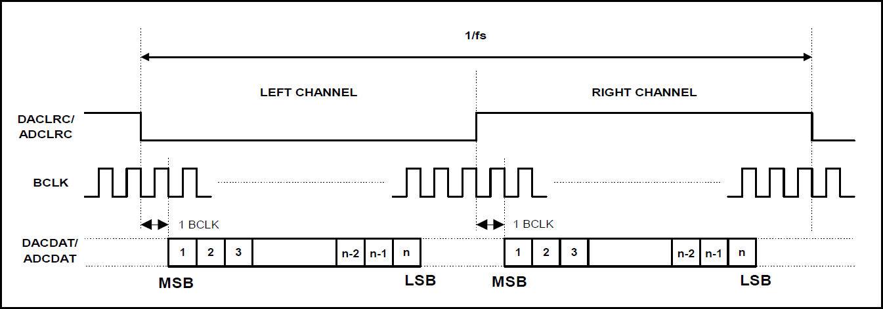
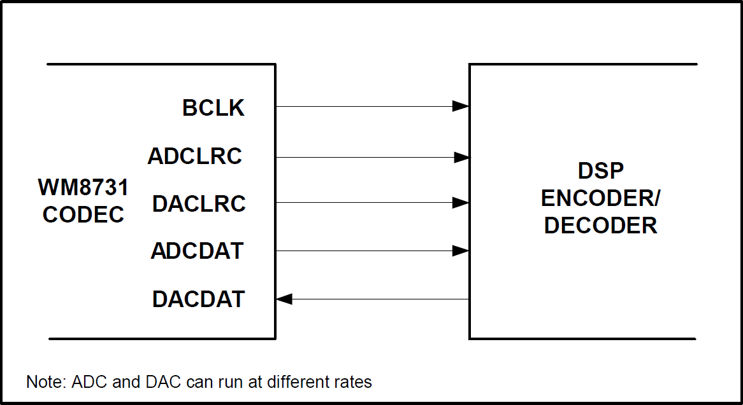
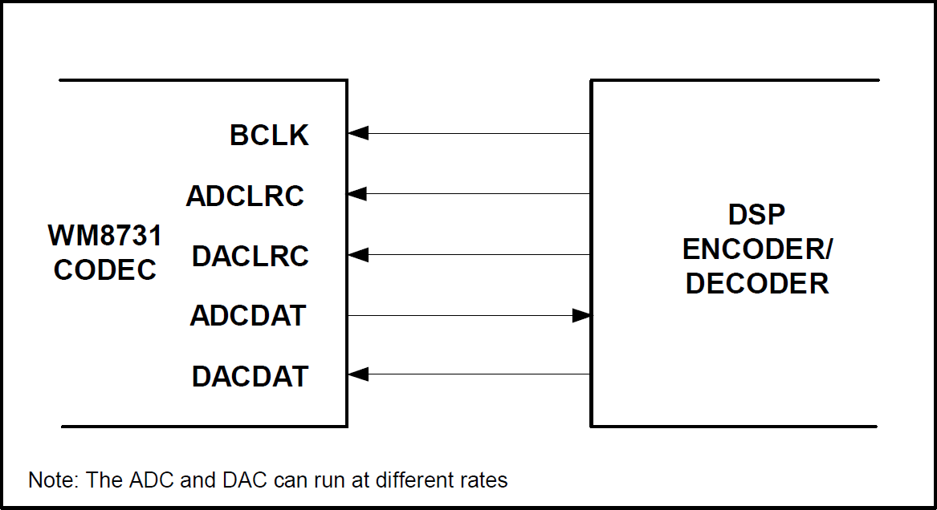
Digital Audio Interface Format (2/2)
I²S format
Master mode v.s. Slave mode
16-bit length

Slide 38
Sampling Control (1/2)
Choose USB mode (fixed MCLK 12MHz) and sampling rate = 32 kHz, BOSR = 0.
000_1000_0_0001_1001
REGISTER | BIT[8] | BIT[7] | BIT[6] | BIT[5] | BIT[4] | BIT[3] | BIT[2] | BIT[1] | BIT[0] | DEFAULT
R8 (08h) Sampling Control | 0 | CLKODIV2 | CLKIDIV2 | SR[3:0] |  |  |  | BOSR | USB/ Normal | 0_0000_0000

Slide 39
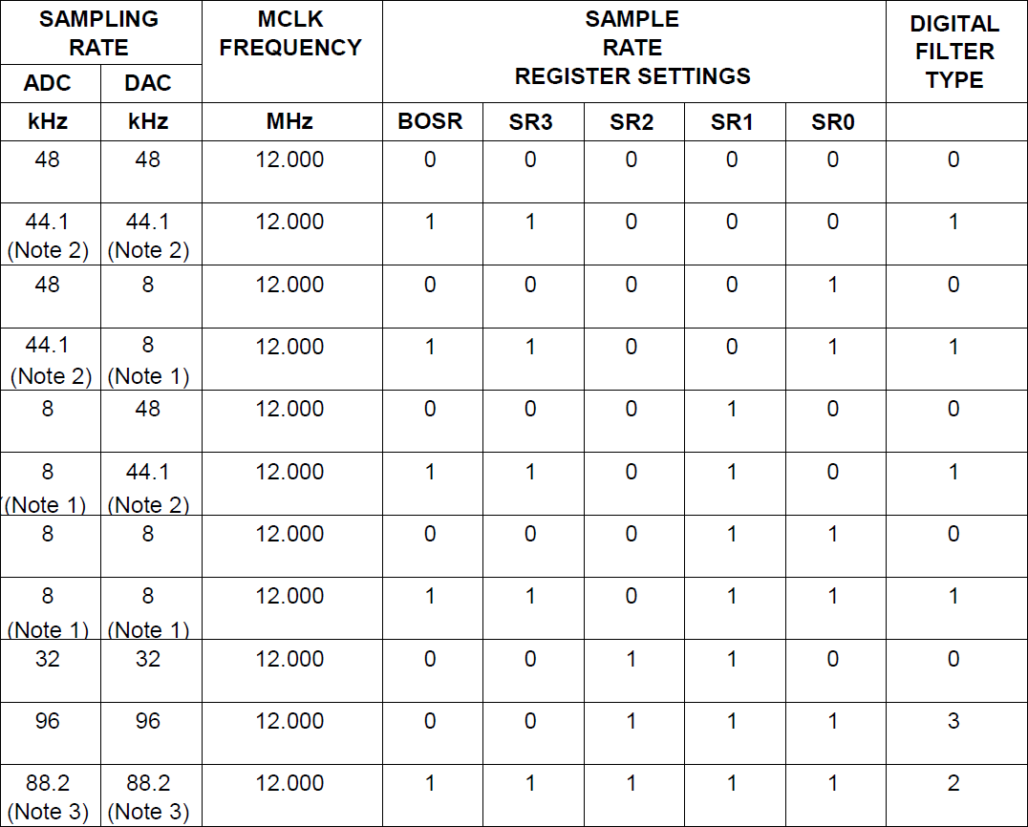
Sampling Control (2/2)
Use PLL to get 12MHz (11.2896MHz) clock!

Slide 40
Active Control
Activate interface
000_1001_0_0000_0001
REGISTER | BIT[8] | BIT[7] | BIT[6] | BIT[5] | BIT[4] | BIT[3] | BIT[2] | BIT[1] | BIT[0] | DEFAULT
R9 (09h) Active Control | 0 | 0 | 0 | 0 | 0 | 0 | 0 | 0 | Active | 0_0000_0000

Slide 41
Reset Register
You can try to reset the device to a known (?) state.
000_1111_0_0000_0000 (?)
REGISTER | BIT[8] | BIT[7] | BIT[6] | BIT[5] | BIT[4] | BIT[3] | BIT[2] | BIT[1] | BIT[0] | DEFAULT
R15 (15h) Active Control | RESET[8:0] |  |  |  |  |  |  |  |  | not reset

Slide 42
Recommended settings
Left Line In | 000_0000_0_1001_0111
Right Line In | 000_0001_0_1001_0111
Left Headphone Out | 000_0010_0_0111_1001
Right Headphone Out | 000_0011_0_0111_1001
Analogue Audio Path Control | 000_0100_0_0001_0101
Digital Audio Path Control | 000_0101_0_0000_0000
Power Down Control | 000_0110_0_0000_0000
Digital Audio Interface Format | 000_0111_0_0100_0010
Sampling Control | 000_1000_0_0001_1001
Active Control | 000_1001_0_0000_0001

Slide 43
Check the Waveform
24’h890abc (3 bytes).
How fast should the clock be (see the spec)?
How will you design your FSM?
Possible: 2 clocks for begin and end, and 3 clocks per bit.
I have provide a testbench and the interface is similar to lab2.

Slide 44
Device Operation

Slide 45
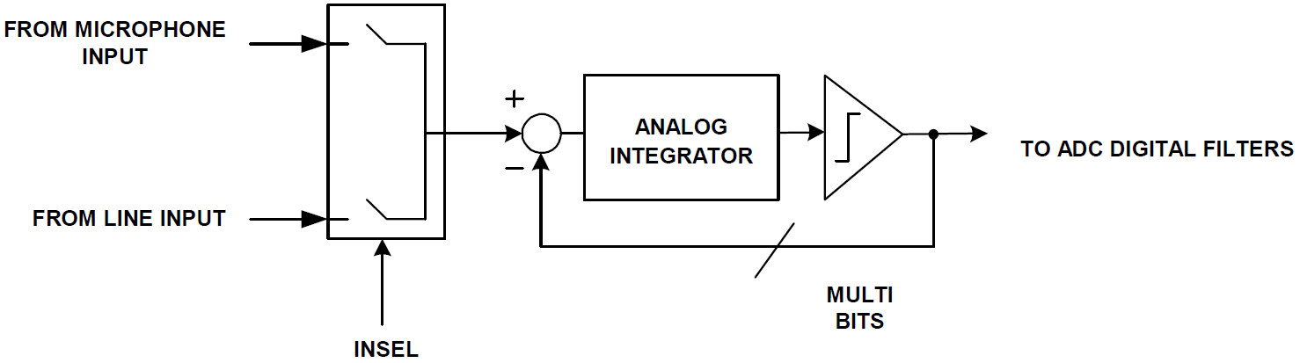
ADC
The WM8731/L uses a multi-bit oversampled sigma-delta ADC. A single channel of the ADC is illustrated below.

Slide 46
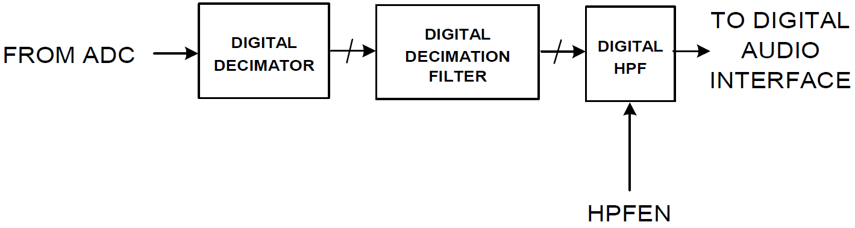
ADC Filters
The ADC filters perform true 24 bit signal processing to convert the raw multi-bit oversampled data from the ADC to the correct sampling frequency to be output on the digital audio interface.

Slide 47
Digital Audio Interfaces (1/5)
WM8731/L may be operated in either one of the 4 offered audio interface modes. These are:
Right justified
Left justified
I²S (We have chosen this.)
DSP mode
All four of these modes are MSB first and operate with data 16 to 32 bits.

Slide 48
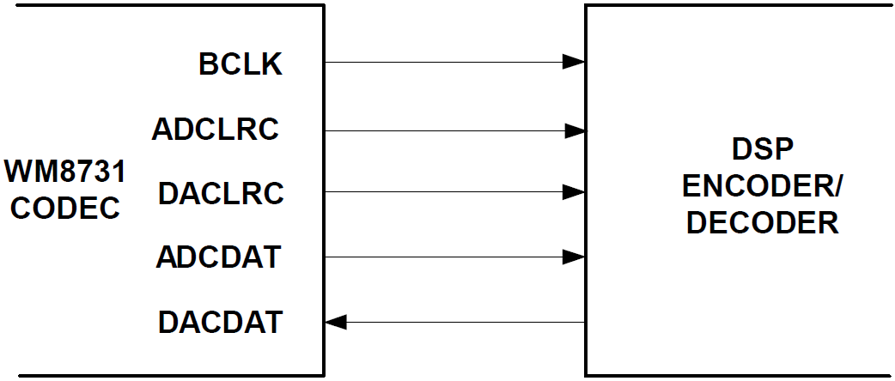
Digital Audio Interfaces (2/5)
Master mode
I²S mode
Notice the 1 clock delay.
n = 16 (we have chosen this), 20, 24, or 32
… in USB mode where BCLK always 12MHz.
… for example, in 12MHz/32k … DACLRC and ADCLRC outputs will have a mark space ratio of 187:188.

Slide 49
Digital Audio Interfaces (5/5)
The length of the digital audio data is programmable at 16/20/24 or 32 bits.
The data is signed 2's complement.
If the ADC is programmed to output 16 or 20 bit data then it strips the LSBs from the 24 bit data.
If the ADC is programmed to output 32 bits then it packs the LSBs with zeros.
Similar adjustments in DAC.

Slide 50
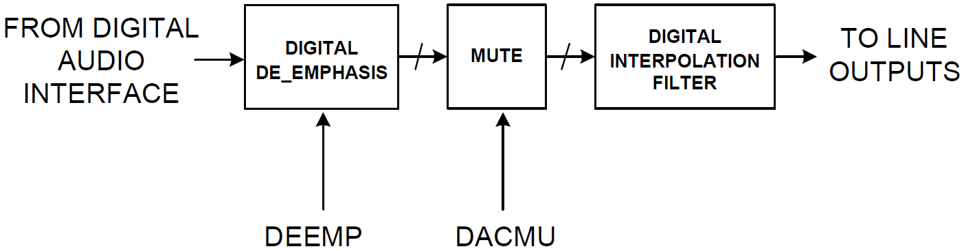
DAC Filters
The DAC filters perform true 24 bit signal processing to convert the incoming digital audio data from the digital audio interface at the specified sample rate to multi-bit oversampled data for processing by the analogue DAC.

Slide 51
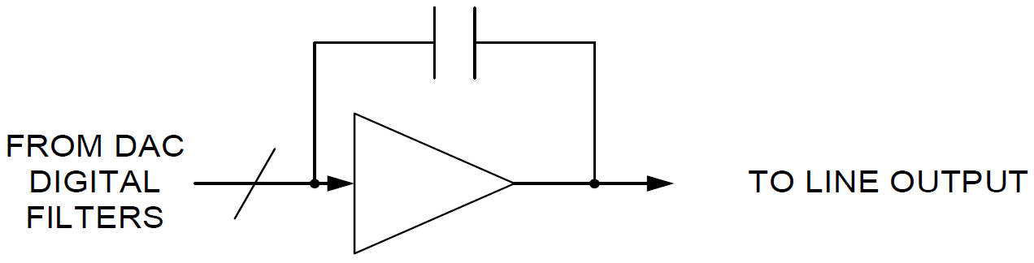
DAC
The WM8731/L employs a multi-bit sigma delta oversampling digital to analogue converter.

Slide 52
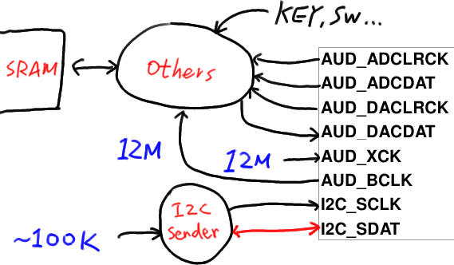
Possible Architecture
You have to use PLL.
Clock crossing is difficult, so we just use the 12MHz clock (What’s new in the sdc file of lab3?).
I2C_SDAT is inout!

Slide 53
The End.
Any question?

Slide 54
Reference
http://en.wikipedia.org/wiki/Audio_signal
http://en.wikipedia.org/wiki/I%C2%B2C
"THE I 2C-BUS SPECIFICATION VERSION 2.1" by Philips.
"DE2-115 User Manual" by Terasic.
"DE2-115_MB.pdf" by Terasic.
"WM8731.pdf" by Wolfson Microelectronics.

